Slide 1
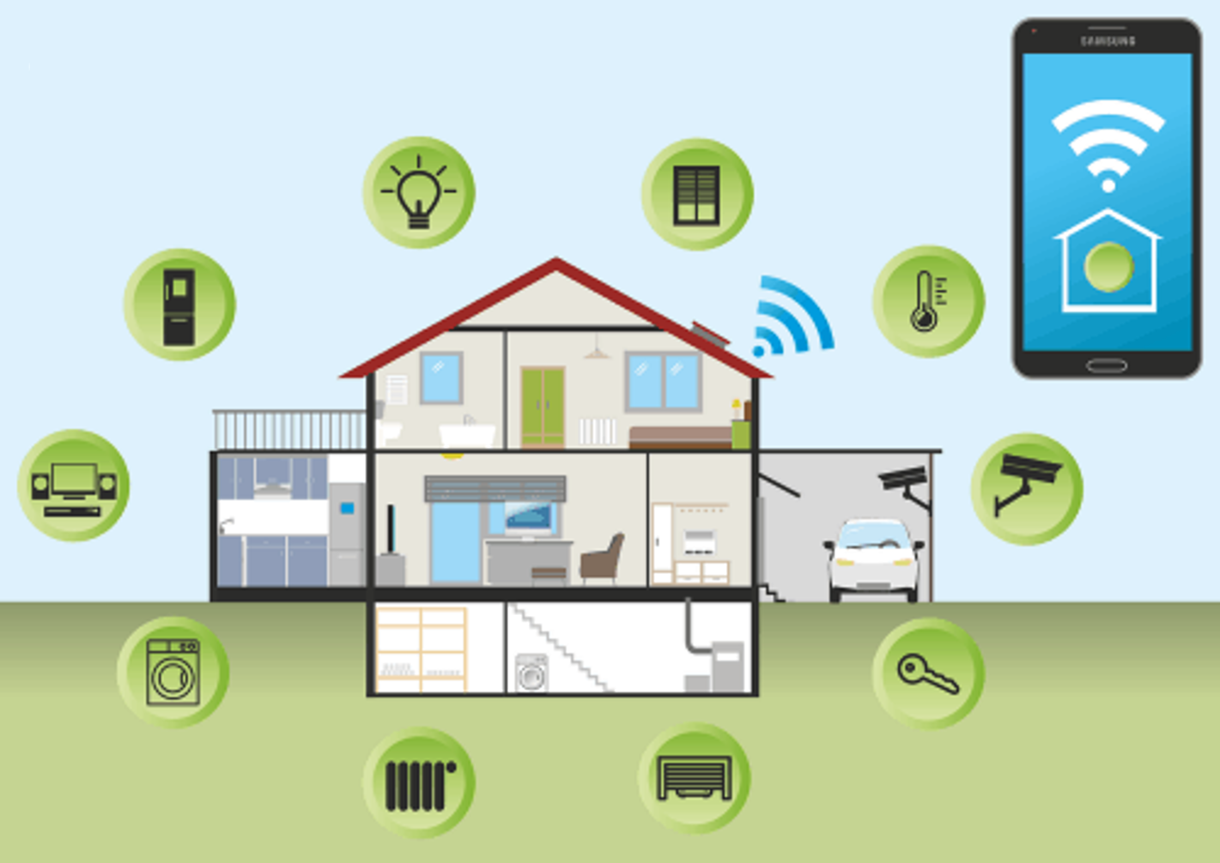
AMIT Learning
Embedded System Project
ABOUT
Smart Home
BY
Mariam El Kess Salib
Group “j-13”

Slide 2
AMIT Learning Project
Idea of Smart Home
“My Project is the main base of a model of a Smart home application”.
The First Microcontroller will be the main control unit (MCU) of this model.
It’s function : linking between the user and the Secondary microcontrollers in the smart home.
Each Secondary Microcontroller controls a group of devices and units that performs certain
function in this home such as :
Natural Lighting Window Curtains & Sun louvres
N.B: Sensors detect the sun angle and determine the needed angle of entered sun light.
Artificial Lighting Light bulbs / Spots.
N.B: Sensor detect the luminous of the room and determine the Light intensity needed.
Air Ventilation Air conditioner / Fans / Windows
N.B: Sensors detect the room temperature & humidity and determine the ventilation needed.
Protection Gas & Smoke & Heat detectors
N.B: Sensors detect the any sudden change in the room atmosphere and takes certain action.
Security Intrusion systems (PIR /IT/CCTV/….)
N.B: Sensors detect any attempt of theft and takes certain actions.
Additional Services Garden irrigation / Playing music/…….
Embedded Systems Course
1

Slide 3
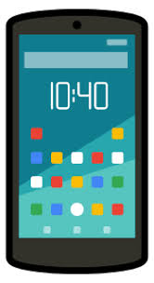
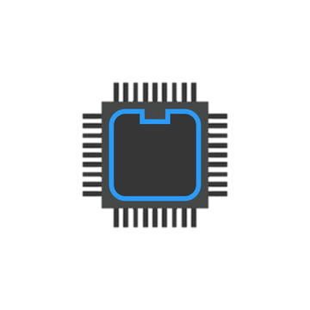
AMIT Learning Project
Diagram shows design of Smart Home
UART Connection
MCU
SPI Connection
Detection
Detection
Detection
Detection
Action
Sensors
Action
Action
Sensors
Action
Natural Lighting
Artificial Lighting
Air Ventilation
Protection & Safety
Embedded Systems Course
2

Slide 4
AMIT Learning Project
Project Components
“My Project Consists of :
Main Microcontroller “MCU” (UART & Master SPI)
Lighting Microcontroller (Slave SPI)
Bluetooth Module (HC-05)
Lcd (shows data to check it)
Led
Project Scenario
User opens mobile Bluetooth application from his smart phone to do a specific operation.
MCU will send message to the user to enter the desired operation using UART Protocol.
The User will send data to light ON/OFF certain led using mobile Bluetooth application .
Data will be sent from smart phone to MCU using Bluetooth module (HC-05) by UART Protocol.
MCU will receive data and show it on LCD (for check)
MCU will send data to the microcontroller that controls Lighting by SPI Protocol and waits for a new operation from the user.
Slave Lighting microcontroller will receive data from MCU and send its own data to MCU due to the shift registering of SPI Protocol
Slave microcontroller will take action based on the received data from MCU.
Embedded Systems Course
3

Slide 5
AMIT Learning Project
Project Flowchart
Start
Start
Initialization
UART
SPI_MASTER
LCD
Initialization
SPI_SLAVE
LED
UART send:
“ENTER OPERATION”
Polling
SPI receives data
Polling
UART receives data
NO
Data ==‘A’
YES
Led ON
Data != Garbdge
NO
YES
Data ==‘B’
Show data on LCD
YES
Led OFF
SPI send data
NO
UART-MASTER SPI DRIVER
SLAVE-SPI DRIVER
Embedded Systems Course
4

Slide 6
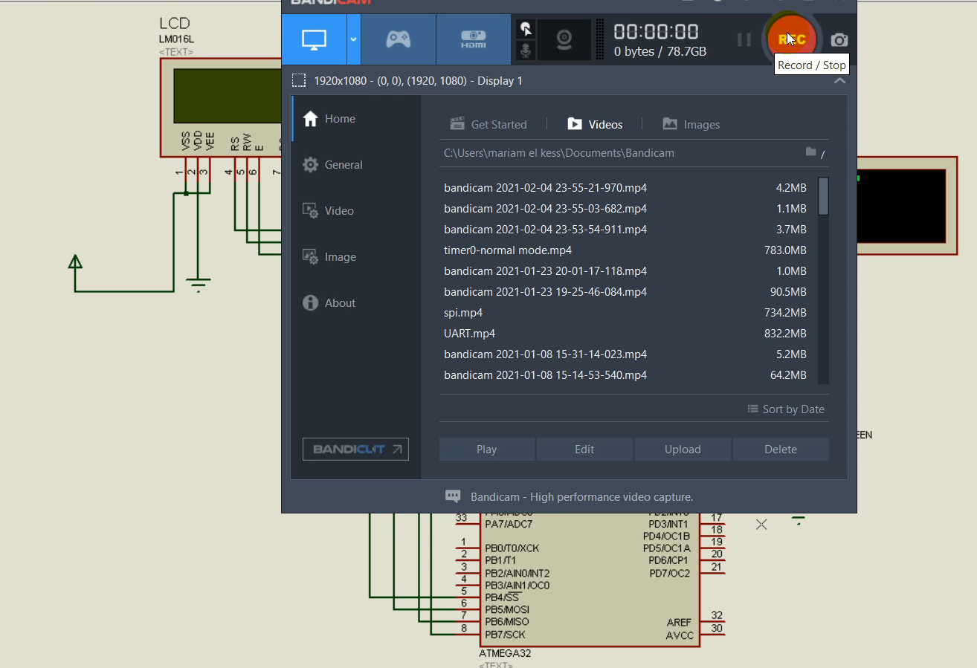
AMIT Learning Project
Project Simulation on Proteus 7.7
MCU
LCD
(for data check)
Virtual Terminal
(acts as HC-05)
LED
Virtual Terminal
Window
Slave
Micro controller
*Main Video : In sent Files
Embedded Systems Course
5

